Slide 1
SUPPLY CHAIN MANAGEMENT SYSTEM
Under Guidance of: Prof. </Faculty Name>
Group Members

Slide 2
Outline
Introduction
Problem Statement
Objectives
Literature Survey
Proposed System/System Design
Technologies Used
Results Analysis
Conclusion
Future Scope
Q&A

Slide 3
Introduction
• Supply Chain Management coordinates the flow of products, information, and orders from suppliers to customers.
• A web-based SCM system provides a centralized platform for inventory, suppliers, customers, and order tracking.
• The proposed project uses Full Stack Java to build a secure, scalable, database-driven application.
• It reduces manual work and improves visibility of stock and order status.

Slide 4
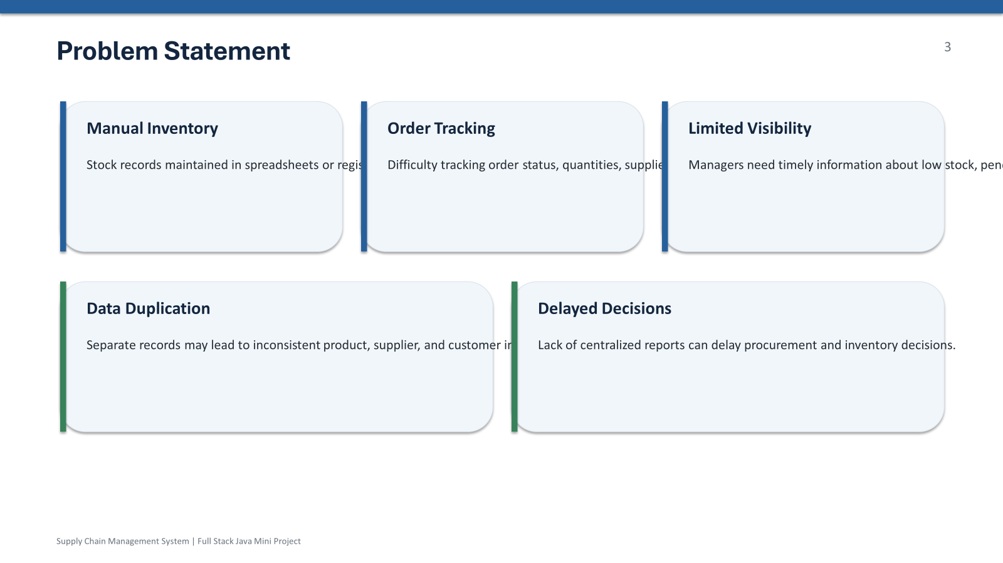
Problem Statement

Slide 5
Objectives
• Develop a centralized web application for supply-chain operations.
• Implement CRUD operations for products, suppliers, customers, and inventory.
• Track customer orders from creation through fulfillment.
• Provide role-based login and secure access to application functions.
• Generate dashboard information and reports for better decision-making.
• Use a relational database to maintain consistent and retrievable business data.

Slide 6
Literature Survey
Summary of 2 to 3 base papers, existing methods, or similar systems.
Sr. No. | Title of Paper | Conference/Publication Name , Date | Merits | Demerits
1
2

Slide 7
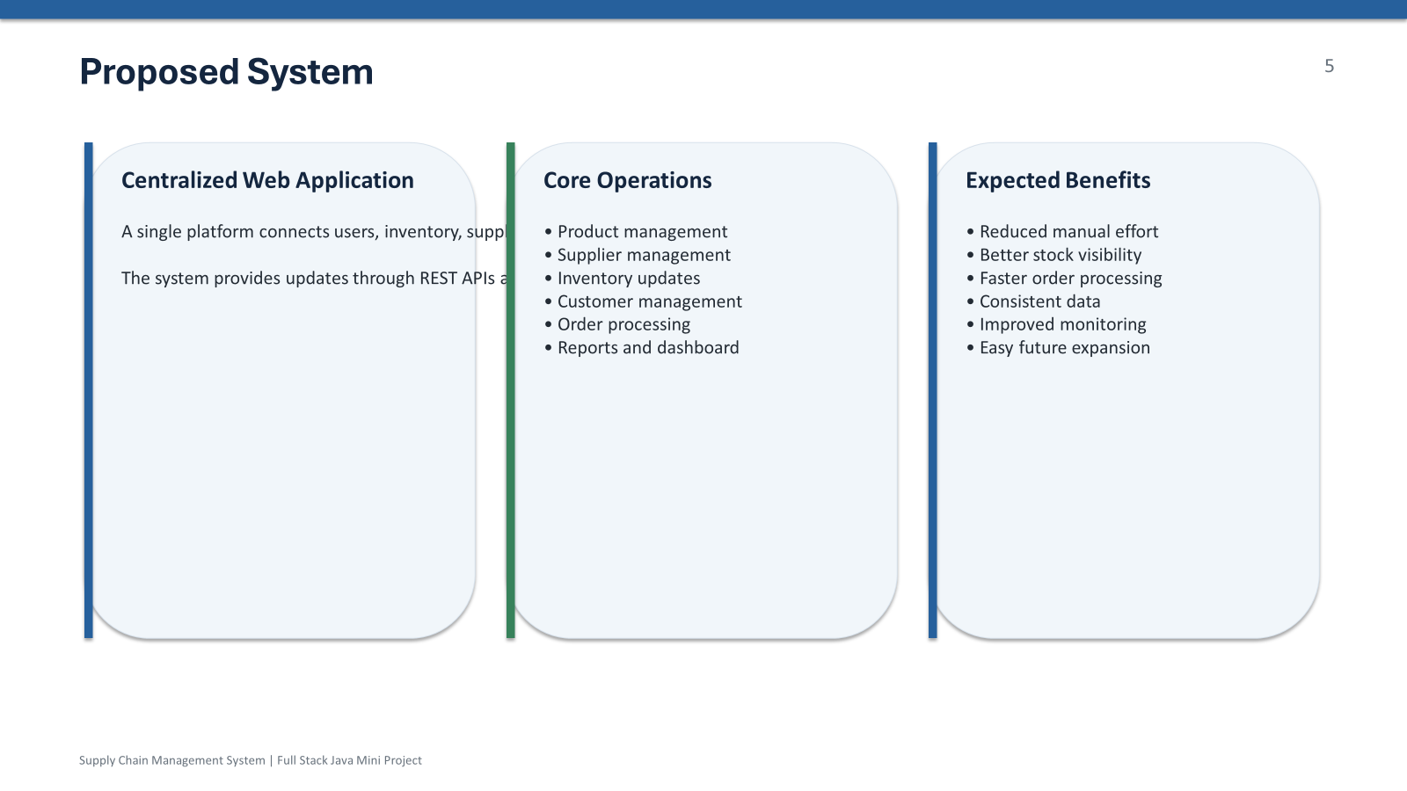
Literature Survey
Summary of 2 to 3 base papers, existing methods, or similar systems.

Slide 8
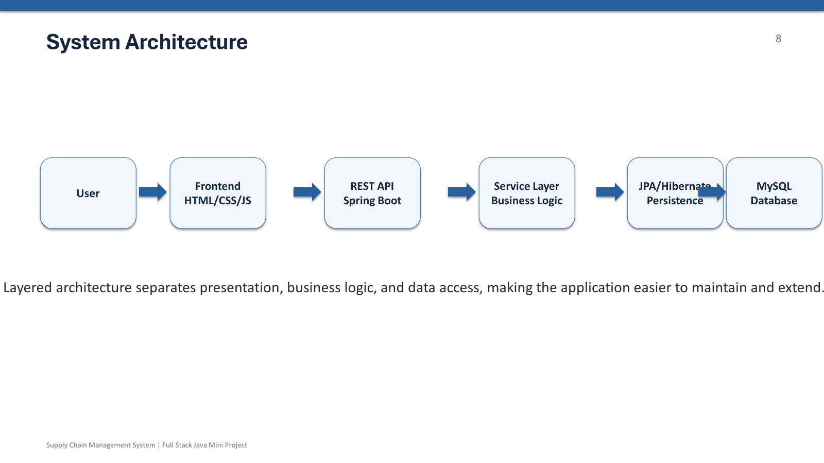

Slide 9
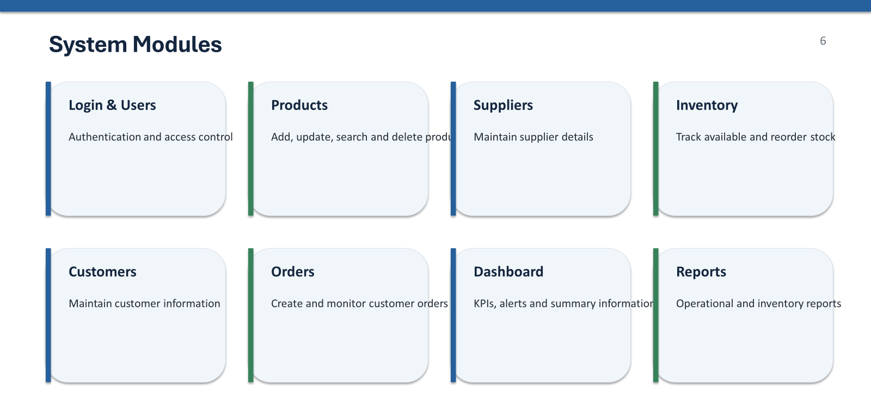

Slide 10
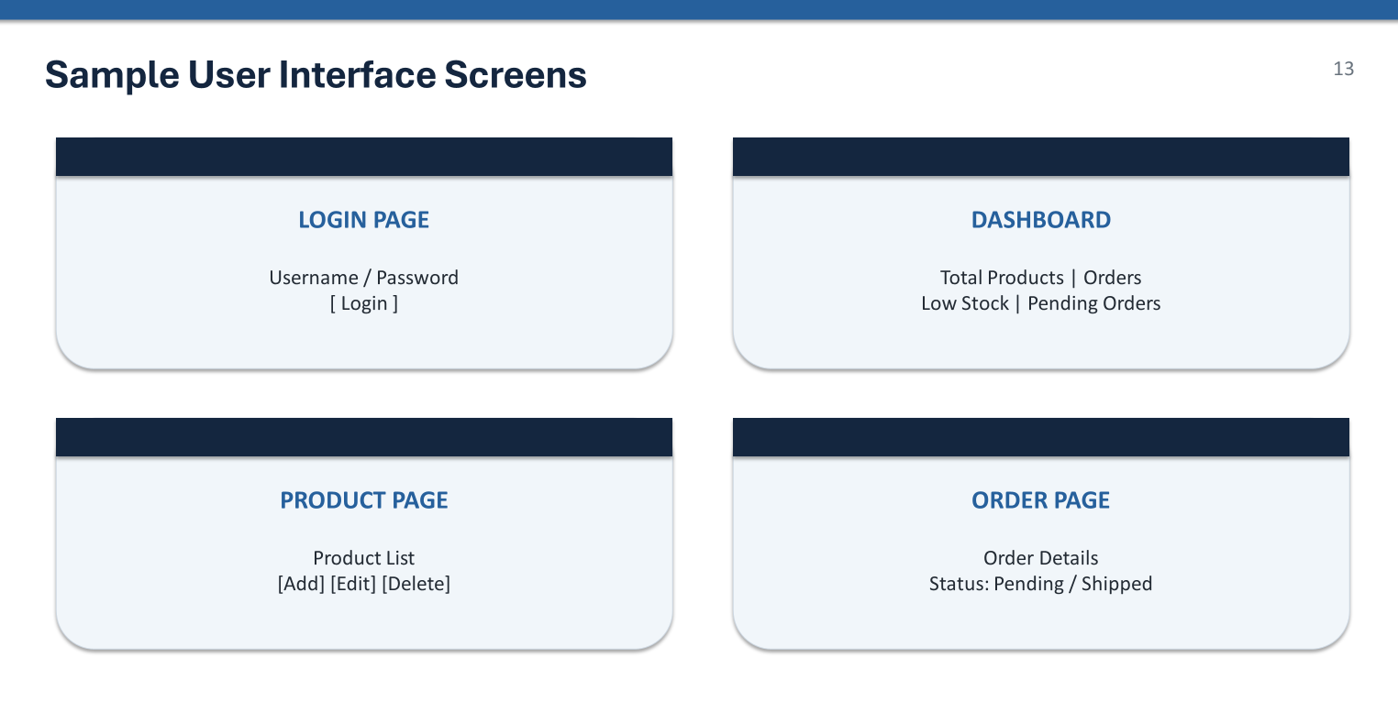

Slide 12
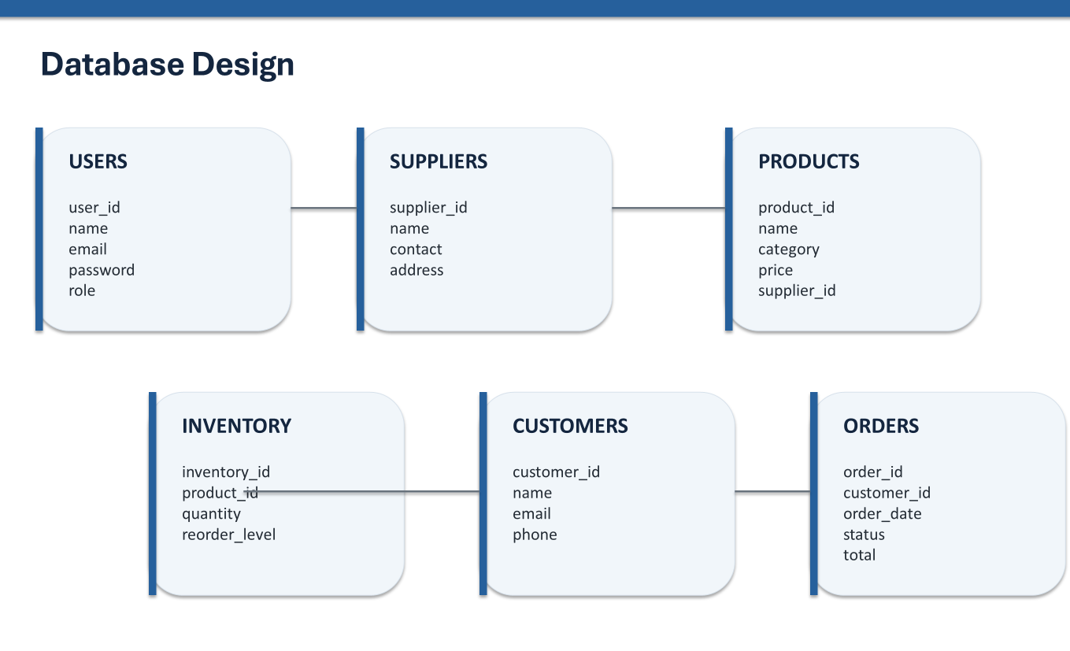

Slide 13
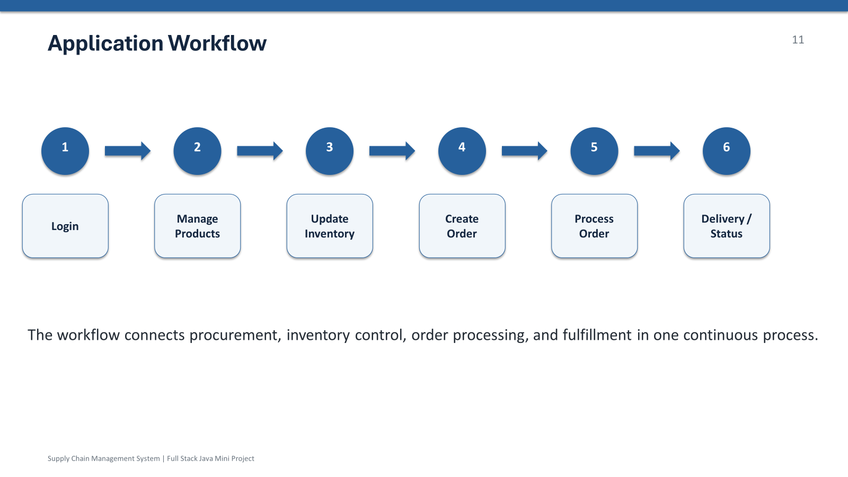

Slide 14
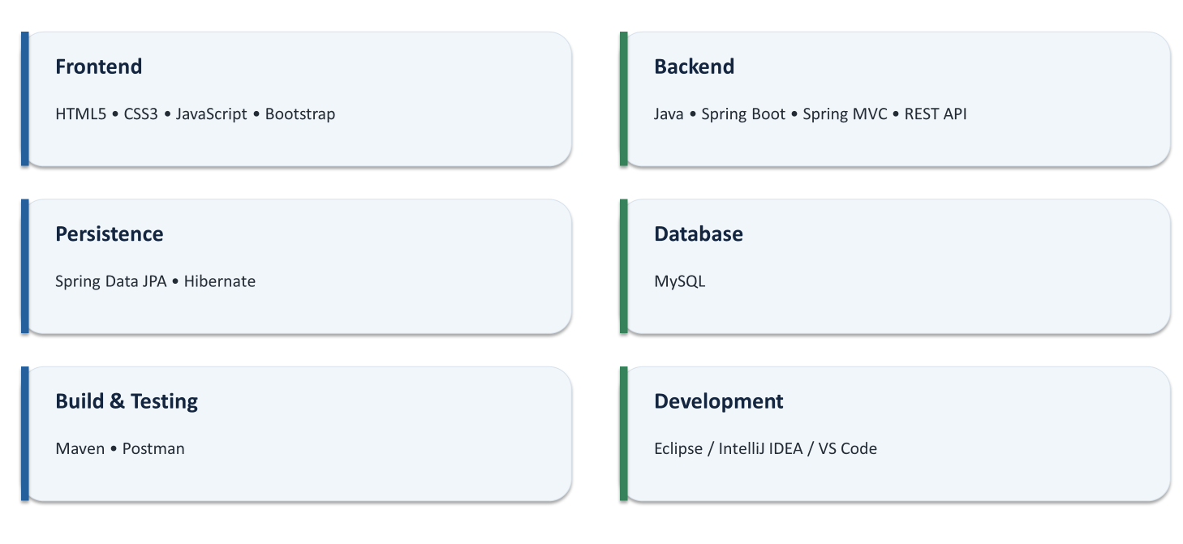
Requirements / Technologies Used

Slide 15
Results and Output
Output screenshots
Graphs
Performance metrics
Achievements

Slide 16
Conclusion
• The Supply Chain Management System integrates products, suppliers, inventory, customers, and orders.
• Full Stack Java supports a structured, secure, and scalable implementation.
• The system can be extended with analytics, forecasting, cloud services, and mobile access.

Slide 17
Next Presentation Plan
Possible improvements
Additional features
Scalability

Slide 18
References
Research papers
Books
Websites
Documentation

Slide 19
Thank You!
Questions?

